Slide 1
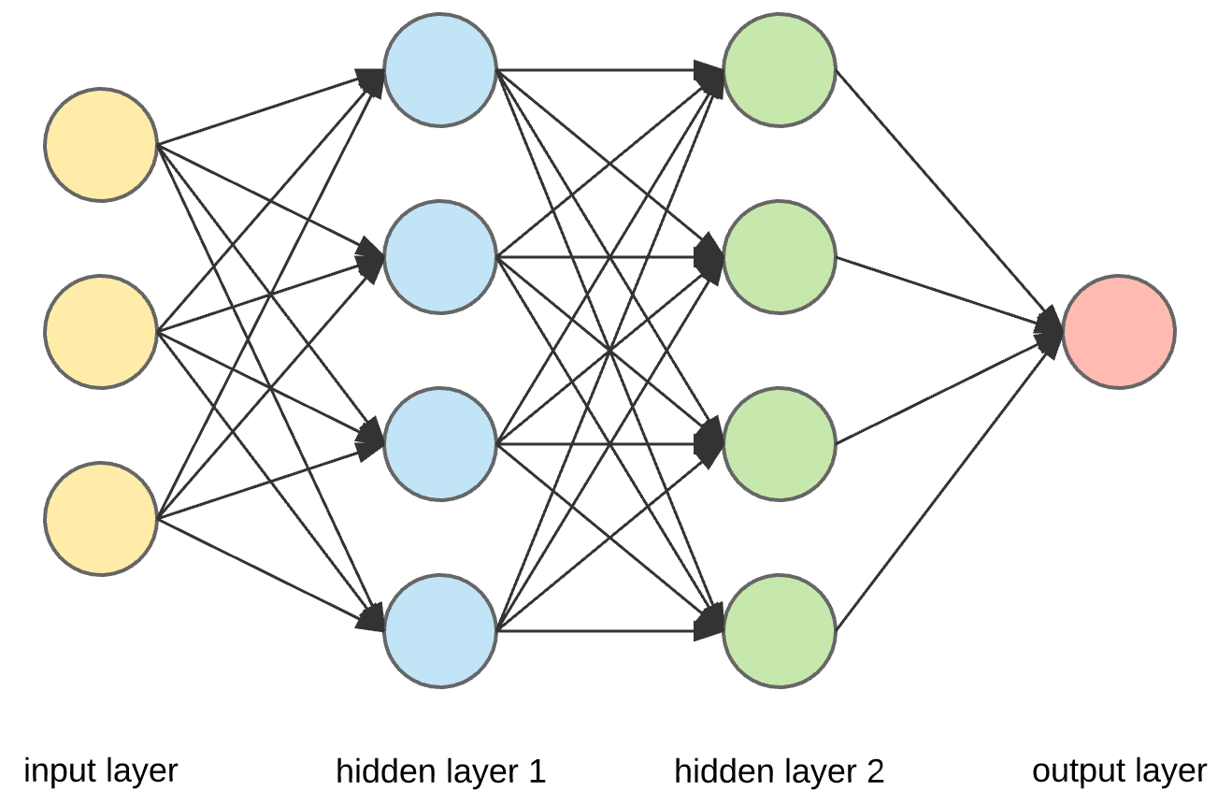
Deep Reinforcement Learning
Agent
Actions
Environment
Rewards
States
Hongning Wang
CS@UVA

Slide 2
Outline
Human-level control through deep reinforcement learning
Revival of reinforcement learning in public’s attention
Mastering the game of Go with deep neural networks and tree search
First time beat top human player in Go game
Mastering the Game of Go without Human Knowledge
Move the solution of Go game far beyond human level
Continuous control with deep reinforcement learning
A popular solution for continuous action control

Slide 3
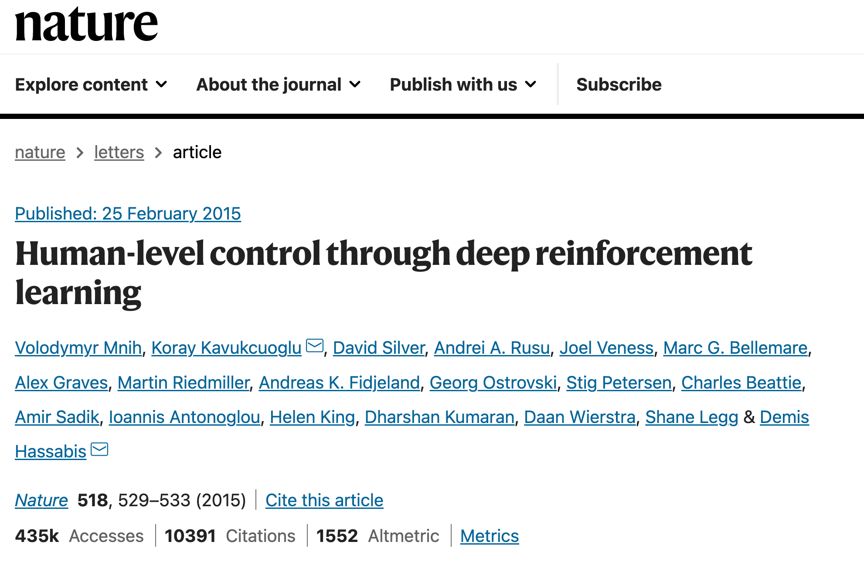

Slide 4
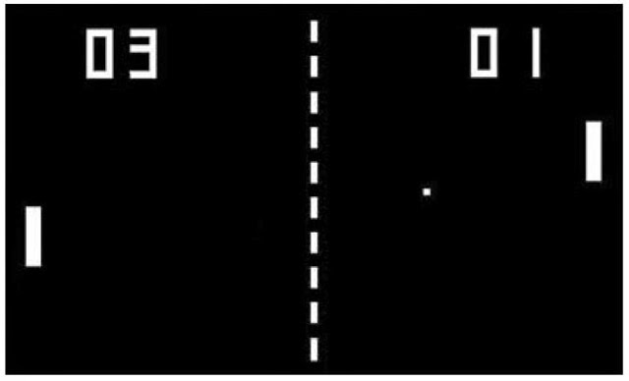
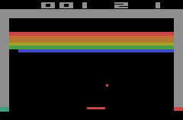
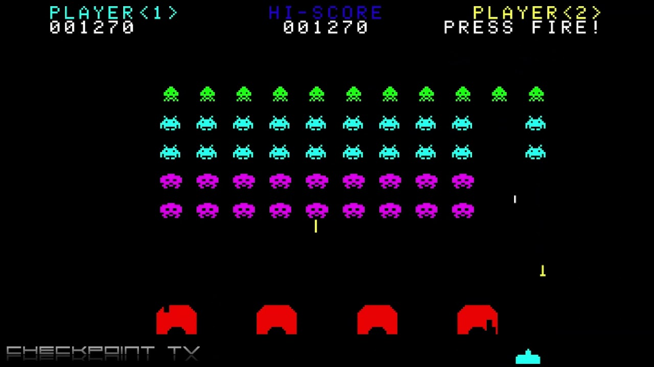
Environment: Atari games
A well-defined reinforcement learning setting
Action space defined by joystick: $→↓←↑,$button press
Reward defined by specific games
State defined by the images in the video stream
State transition defined by game rules
Space Invader
Pong
Breakout

Slide 5
Environment: Atari games
A well-defined reinforcement learning setting
Challenges?
Huge state space!
Almost impossible to encounter every state
Solutions?
Approximation methods for generalization!

Slide 6
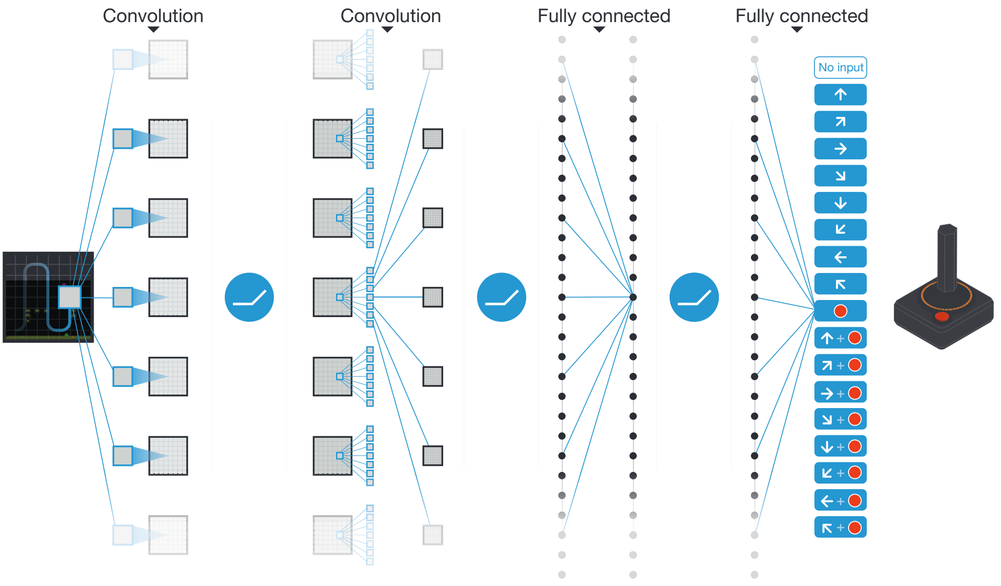
RL with approximation
DeepMind chose Q-learning on top of deep neural networks
State encoder: convolutional neural networks
Value network: multilayer perceptron
Input: 210$×$ 160 color video at 60 Hz
$ε$-greedy for exploration
All actions to be evaluated by the Q-function
RMSProp for neural network estimation

Slide 7
RL with approximation
DeepMind chose Q-learning on top of deep neural networks
Experience replay: periodically revisit historical state-action pairs
A random batch of $U\left(D\right)=\{e_{t}=\left(a_{t},s_{t},r_{t},s_{t+1}\right)\}$ for Q-function update
Benefits
Remove correlations in the observation sequence
Smooth over changes in the data distribution

Slide 8
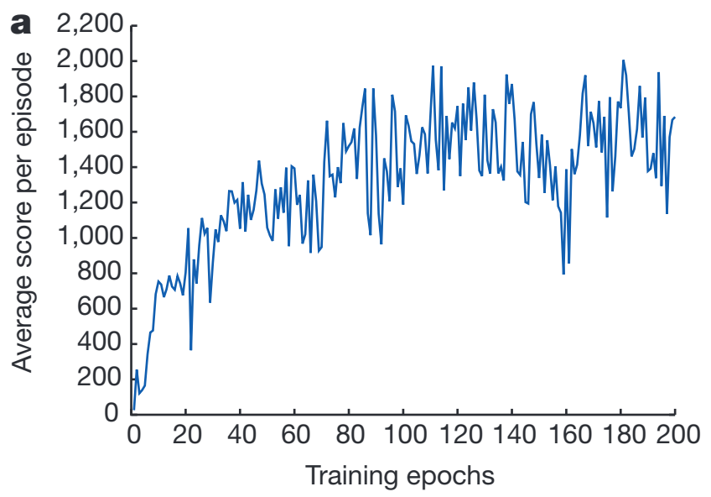
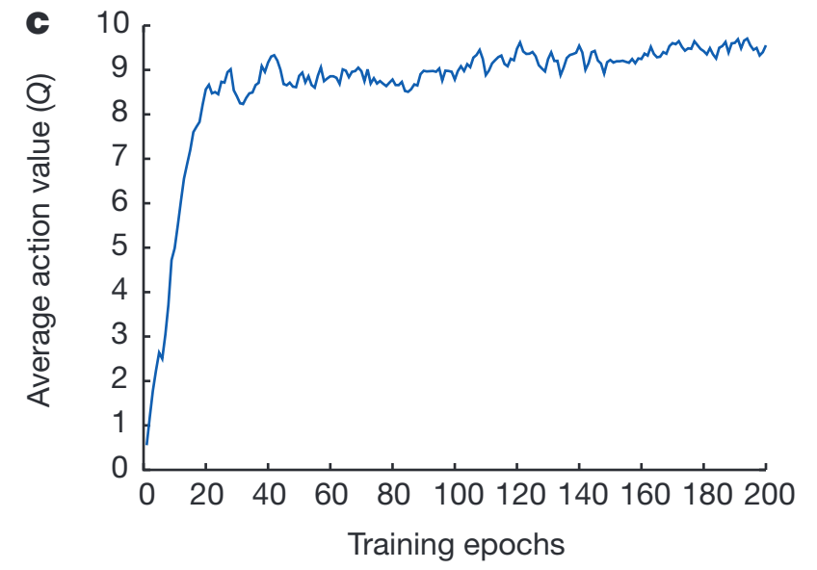
RL with approximation
DeepMind chose Q-learning on top of deep neural networks
Training set
Validation set
Space Invaders after 520k frames

Slide 9
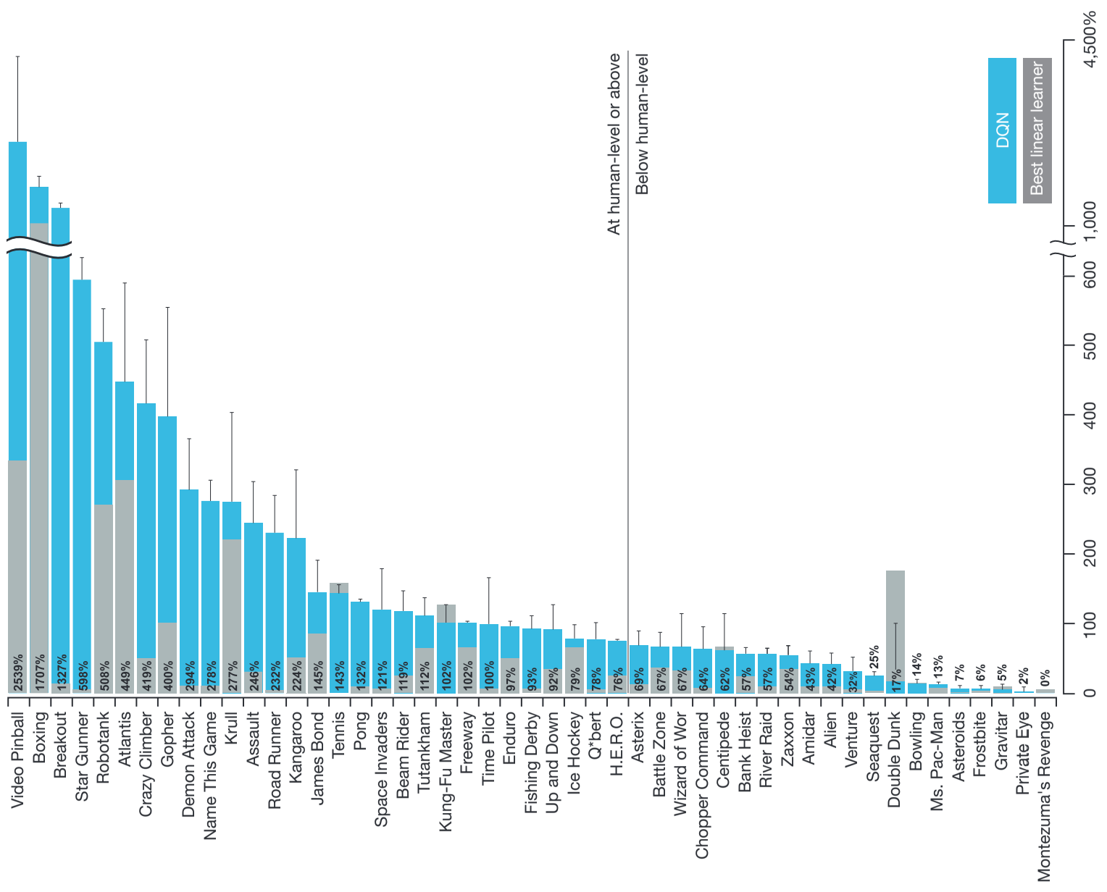
Reach the level of human players
Beat human with a large margin: more than 10x!
Outperform human
Underperform human
Linear approximation based RL

Slide 10
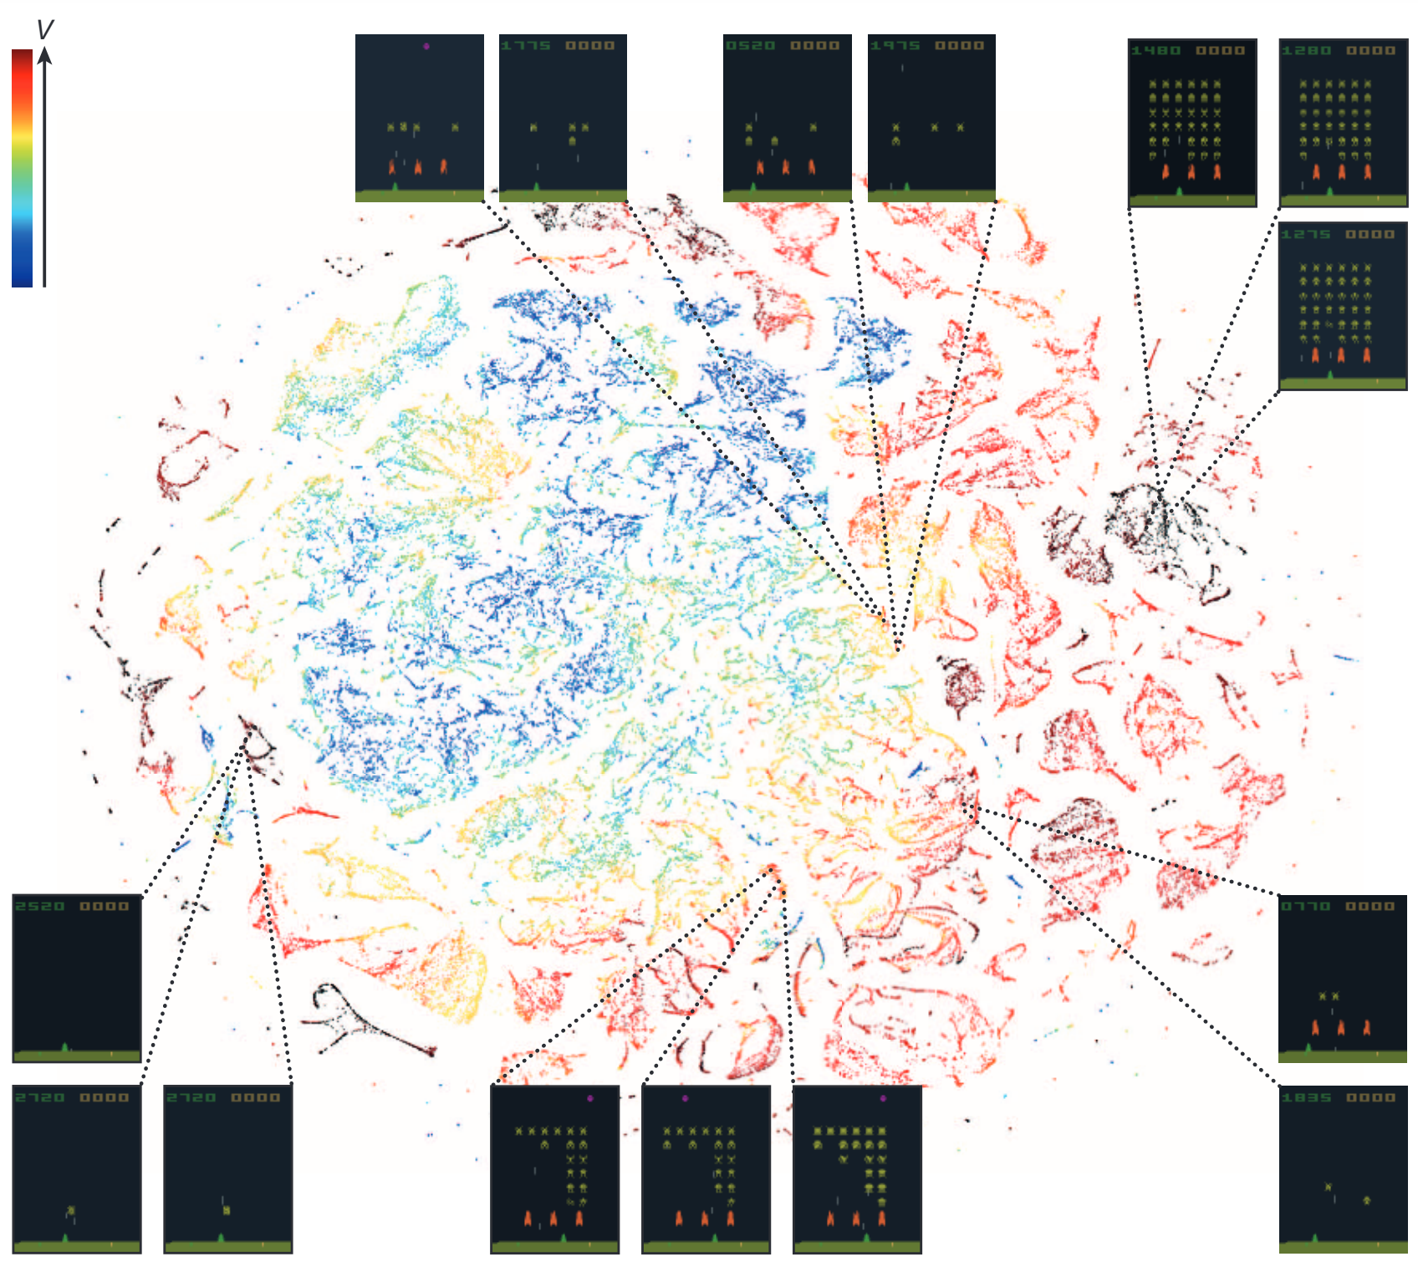
Reach the level of human players
What DQN learns
Similar states share similar representation and therefore optimal action

Slide 11
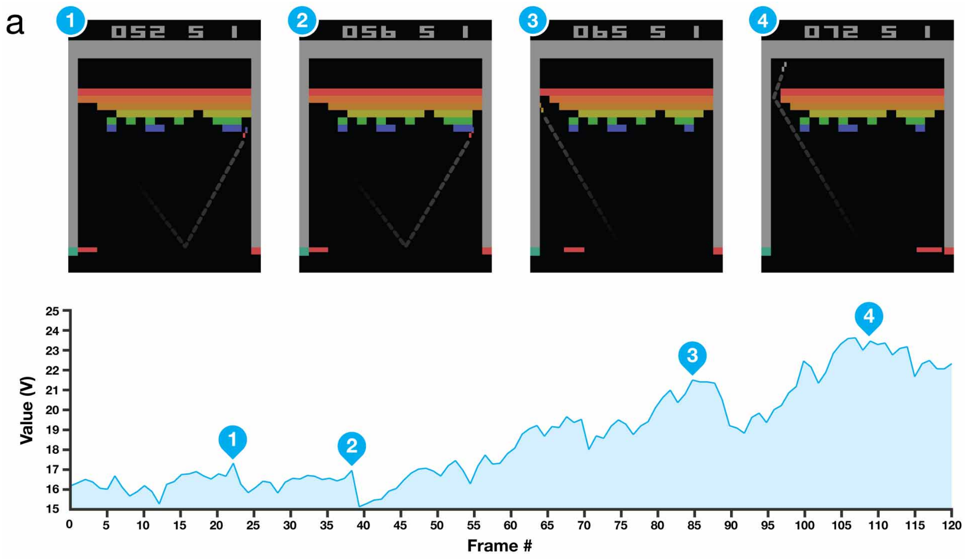
Reach the level of human players
What DQN learns
What is a good state: where to move to
Consistent with human strategy

Slide 12
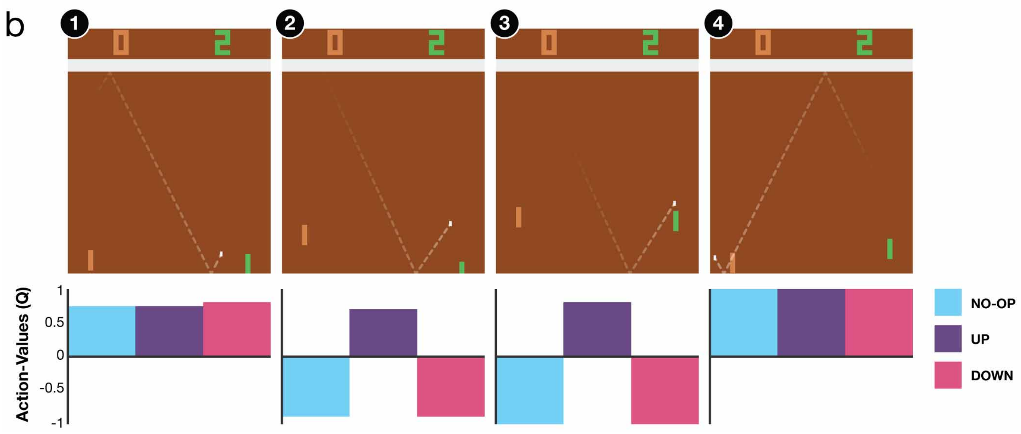
Reach the level of human players
What DQN learns
What is a good action: predict where the ball goes
Catch the ball
Wait for the ball

Slide 13
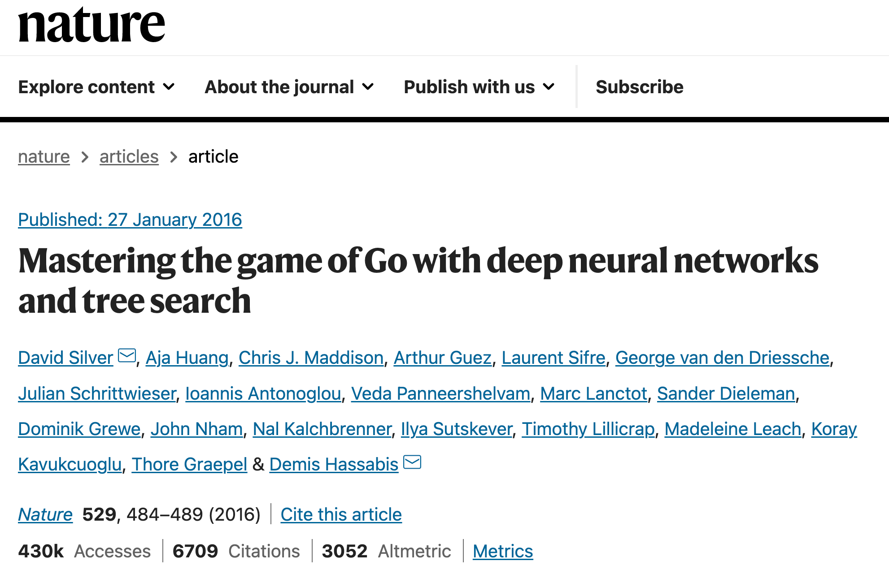

Slide 14
Reinforcement learning for Go game
Is it the same as playing Atari games?
Yes: the environment is well-defined by the game rules
NO
The state space now becomes super huge - ${10}^{172}$ legal states
Delayed reward – no immediate reward until the game finishes

Slide 15
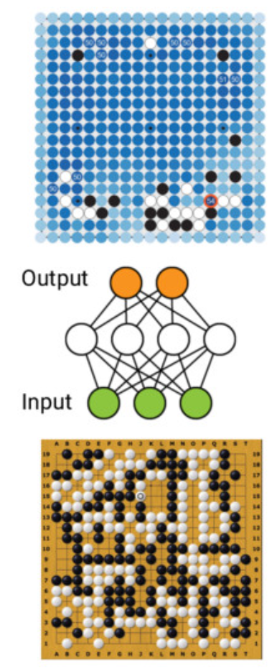
Let’s use the same receipt for Go game
DQN for action taking
State encoding: CNN over 19$×$19 board
Features: stone color, liberties (adjacent empty points of stone’s chain), captures, legality, turns since stone was played, and the current color to play

Slide 16
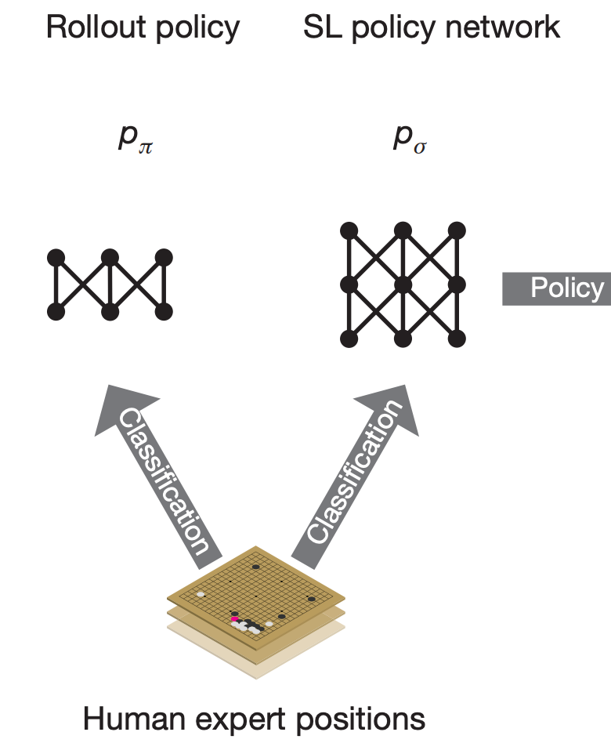
Supervised policy learning
Predicting human expert’s move
Similar to the idea of imitation learning – immediate feedback
Trained on randomly sampled state-action pairs by maximum likelihood
Similar to experience replay? Kind of, but this is from human plays!
As a classification task to warm-start policy network

Slide 17
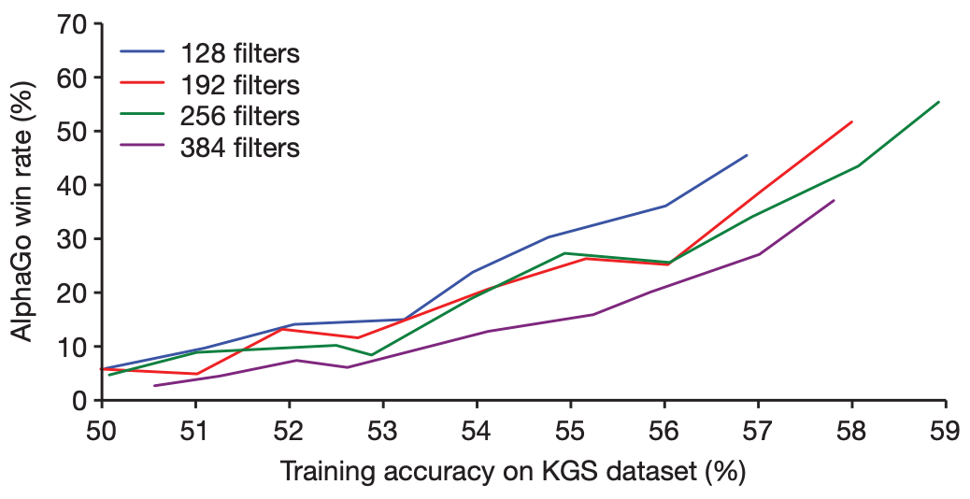
Supervised policy learning
Predicting human expert’s move
13-layer policy network
30 million positions from the KGS Go Server
Accuracy
57% using all features
55.7% only using raw board position and move history
Small increase of prediction accuracy leads to big winning rate against final version of AlphaGo!

Slide 18
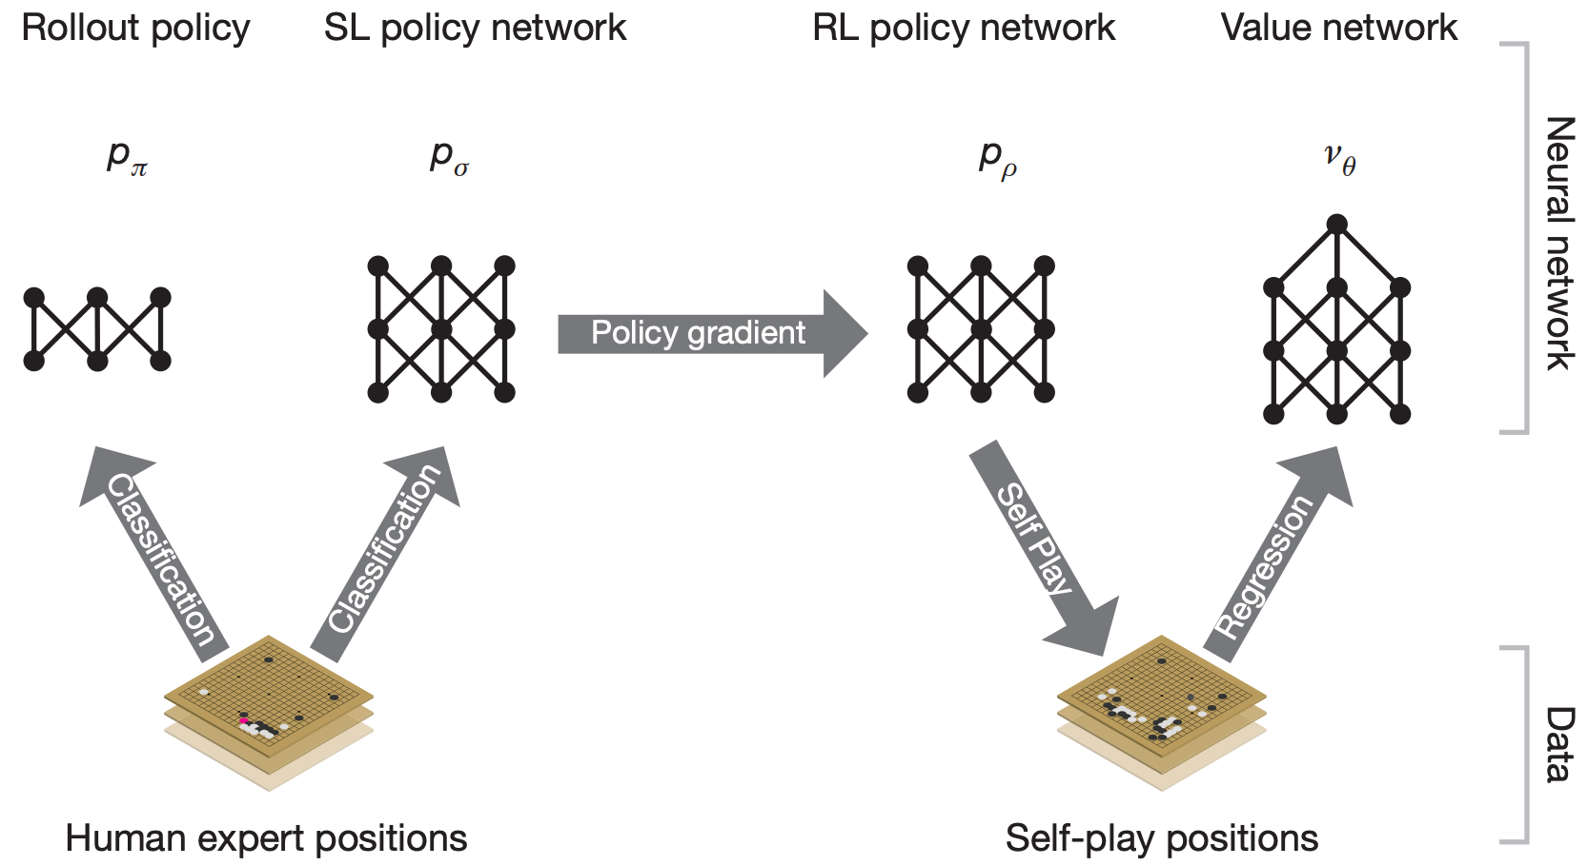
Reinforcement learning policy
Optimize the final outcome of game by self-play
Goal: winning the game, rather than prediction accuracy!
Challenge: only the terminal states have a non-zero reward
Solution: Monte Carlo tree search
Rolling out the policy to the terminal state might take a really long time!

Slide 19
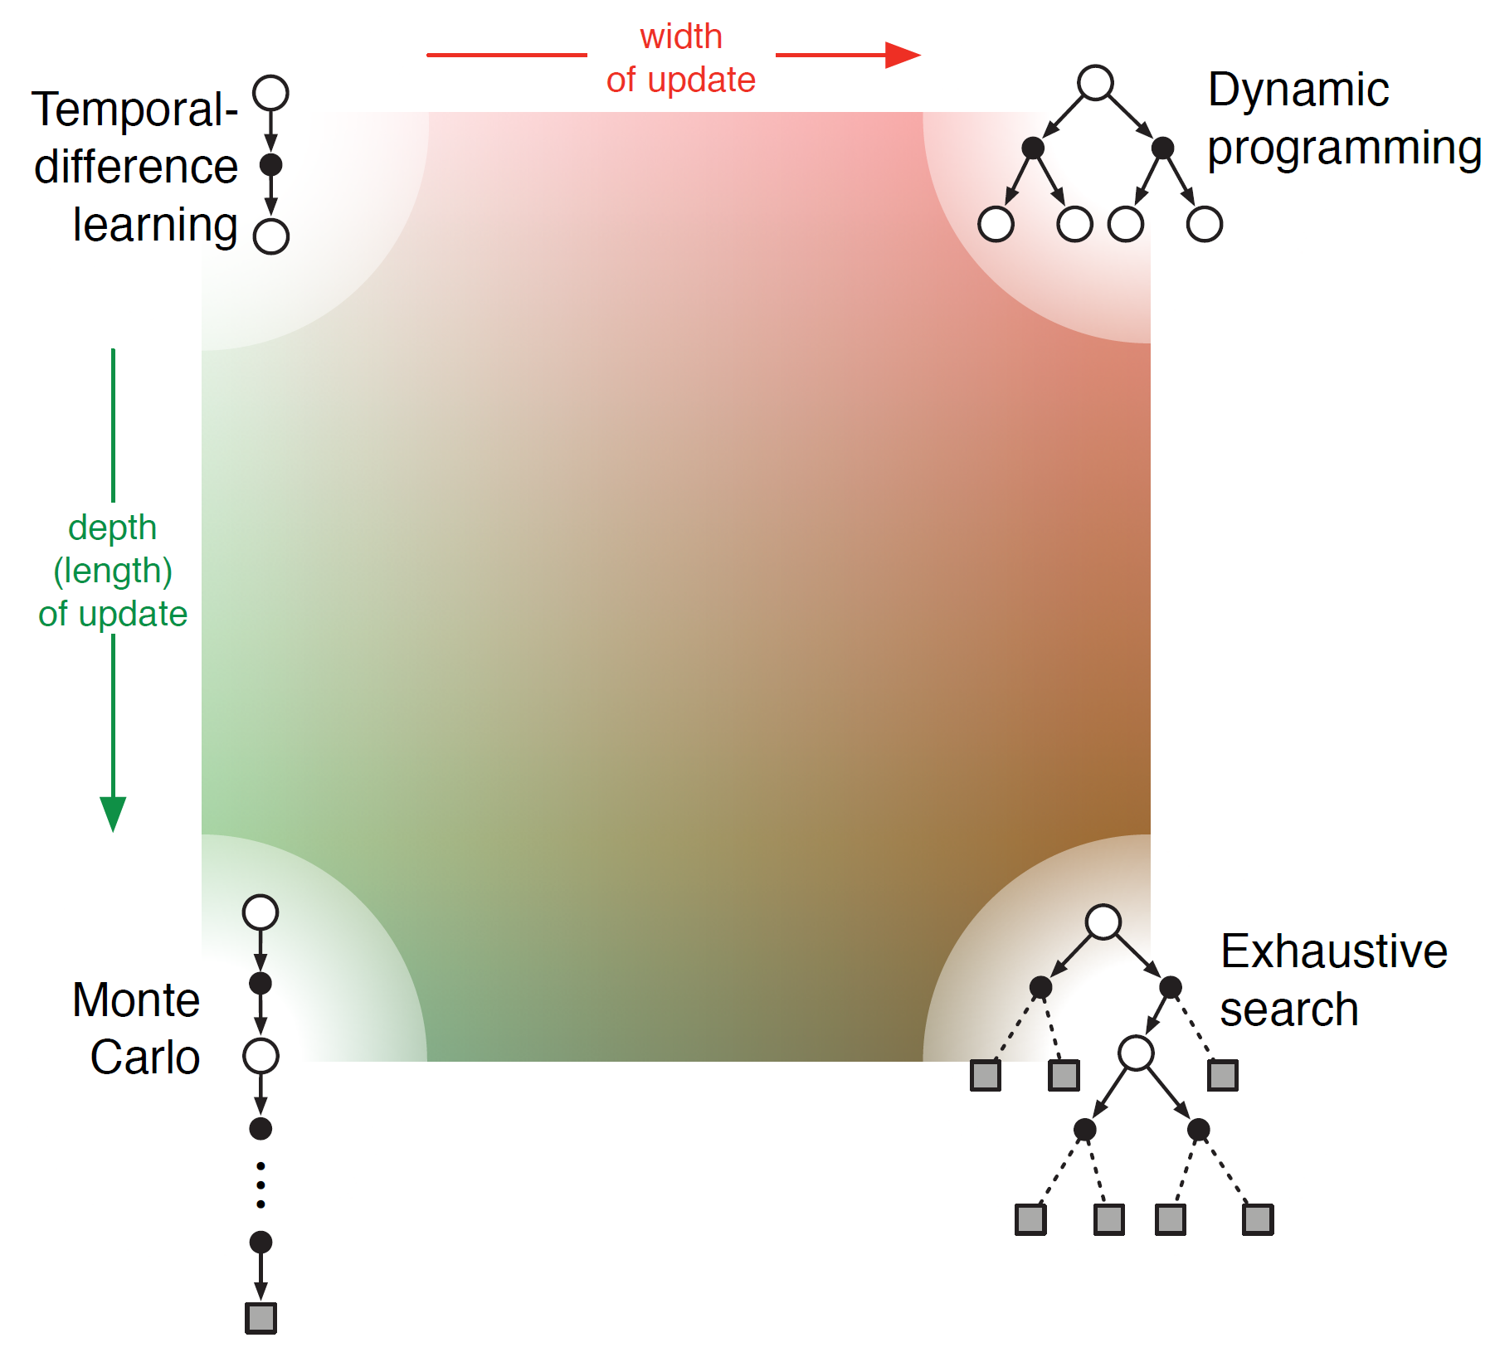
Monte Carlo tree search
A decision-time planning method
When one has perfect model but imperfect state-action values
Avoid exhaust search by heuristics
If exhaustively search to the terminal state, it is dynamic programming
Another compromise in the RL search space

Slide 20
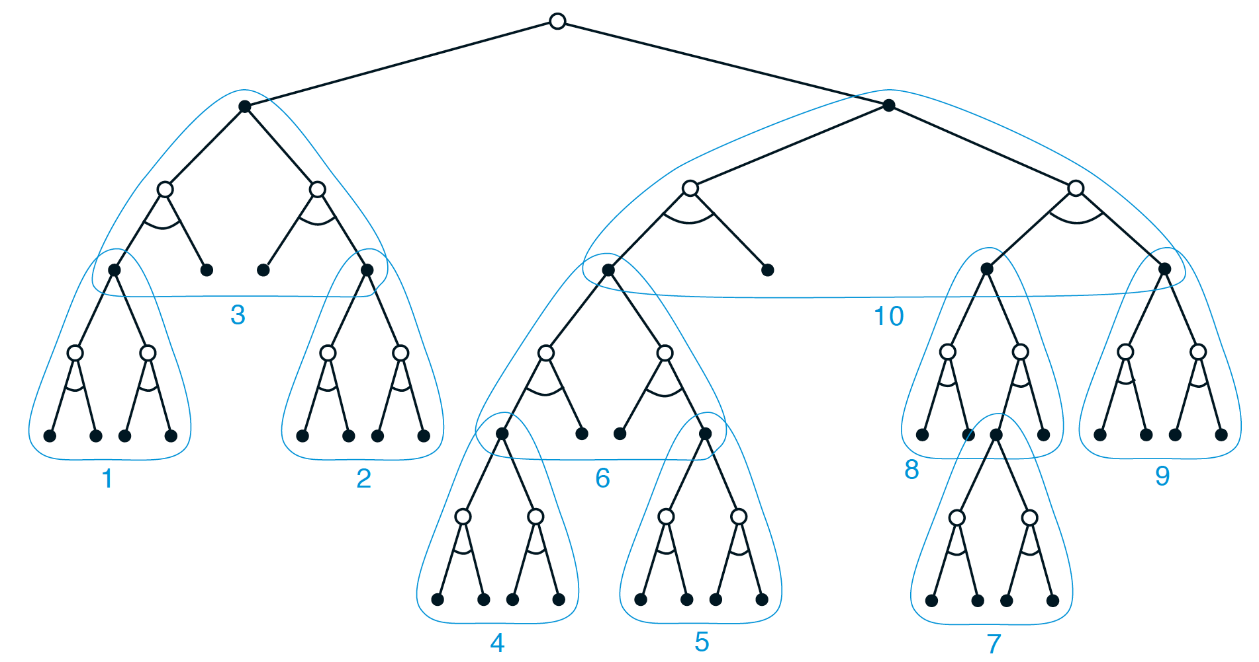
Monte Carlo tree search
A decision-time planning method
When one has perfect model but imperfect state-action values
Avoid exhaust search by heuristics
Branch-and-bound: using the upper confidence bound
Only consider the actions on the leaf nodes in the resulting search tree

Slide 21
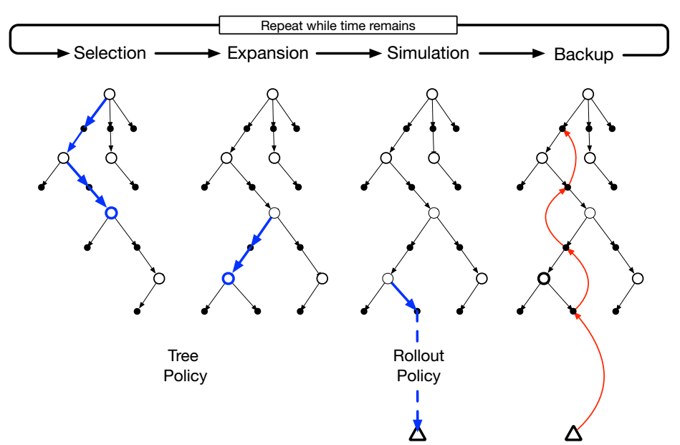
Monte Carlo tree search
A decision-time planning method

Slide 22
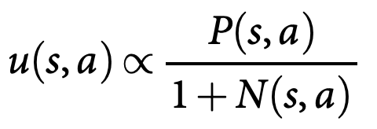
Self-play in AlphaGo
Efficiently approached by Monte Carlo tree search
State transition: play current policy network against a randomly selected previous iteration of the policy network
almost like a UCB, but no theoretical confidence interval
where

Slide 23
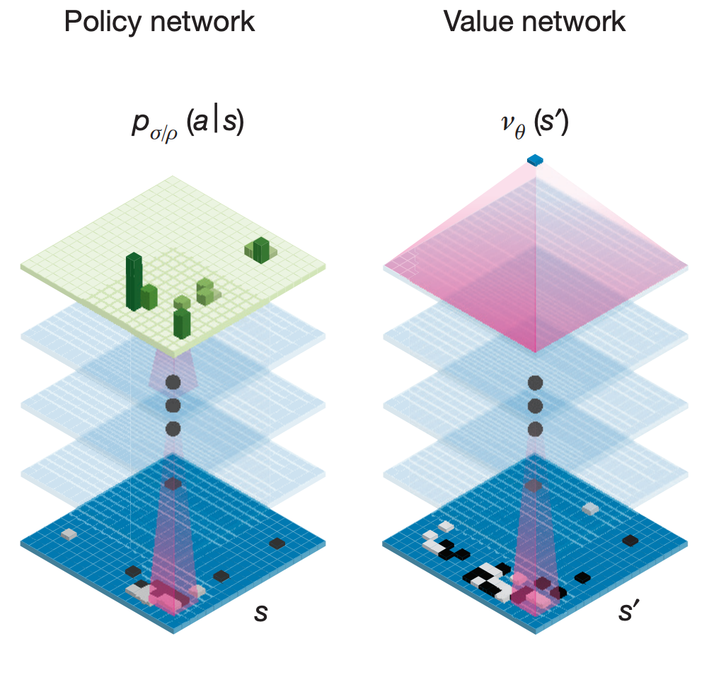
Self-play in AlphaGo
Evaluation in Monte Carlo tree search
Execute the roll-out policy to the end of game
Estimate a value network
Similar to the idea in Actor-Critics
Linearly interpolate the two estimates

Slide 24
Self-play in AlphaGo
Evaluation in Monte Carlo tree search
Practical treatments in executing the roll-out policy to the end of game
Asynchronous multi-threaded search that
executes simulations on CPUs
Computes policy and value networks in
parallel on GPUs

Slide 25
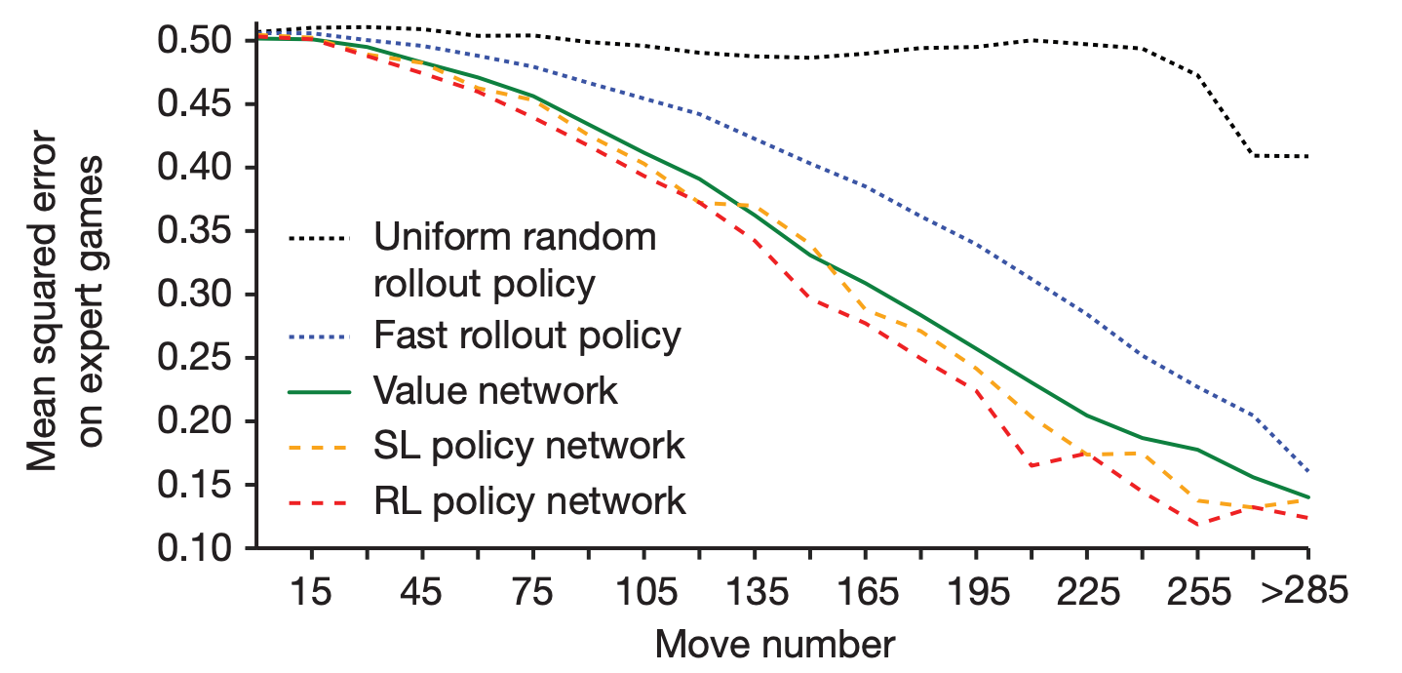
Self-play in AlphaGo
Quality of value estimation
Take advantage of all components

Slide 26
Self-play in AlphaGo
Evaluation in Monte Carlo tree search
Once we can evaluate an action, we can
execute policy gradient for policy learning
from MCTS

Slide 27
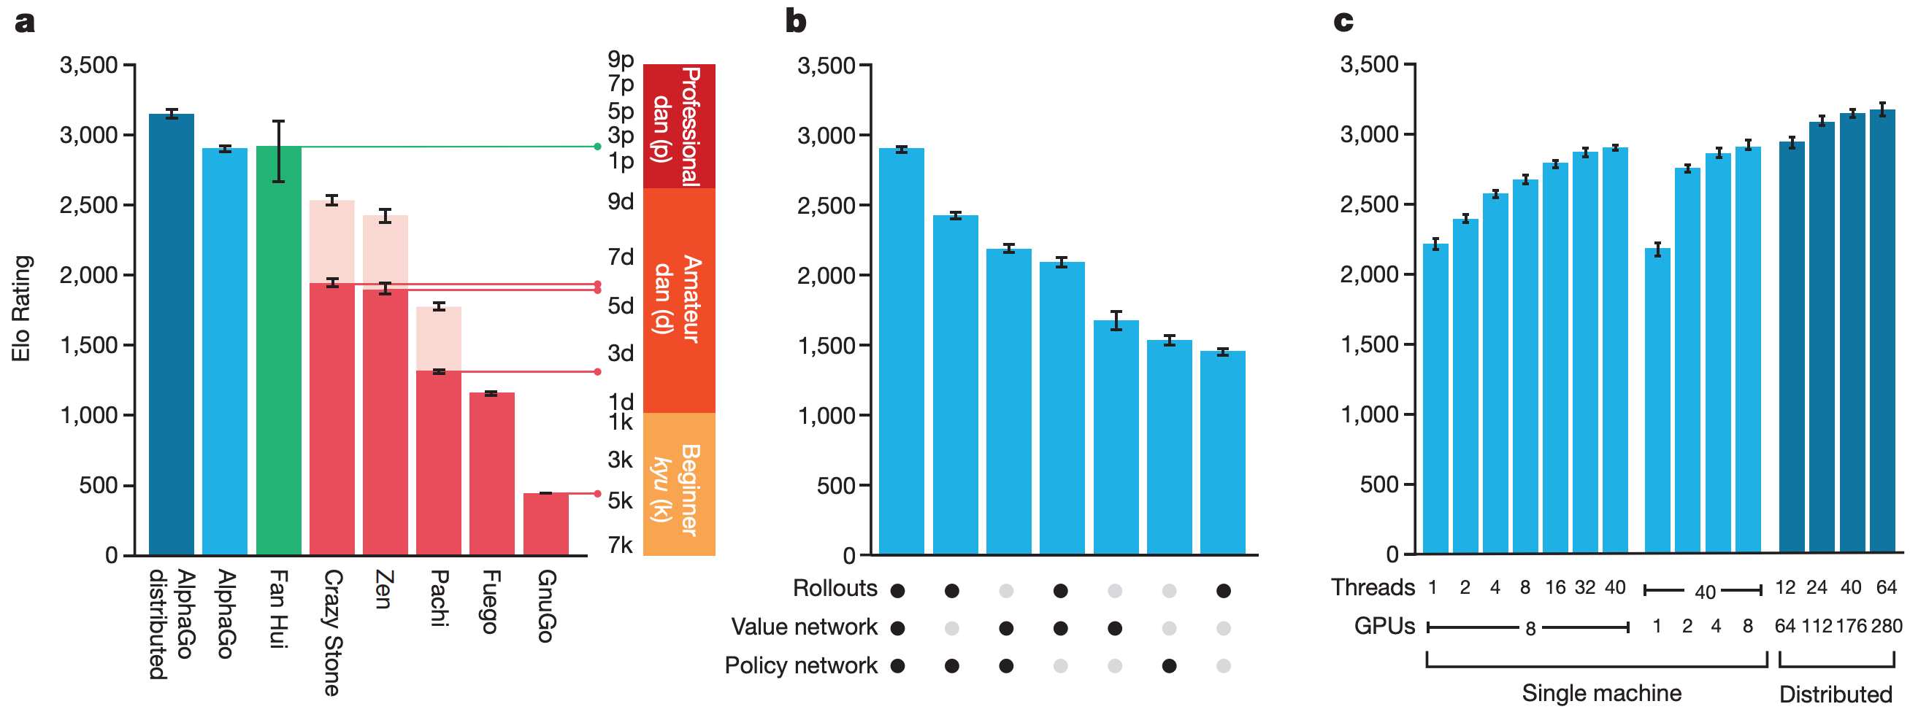
AlphaGo beats top human players

Slide 28
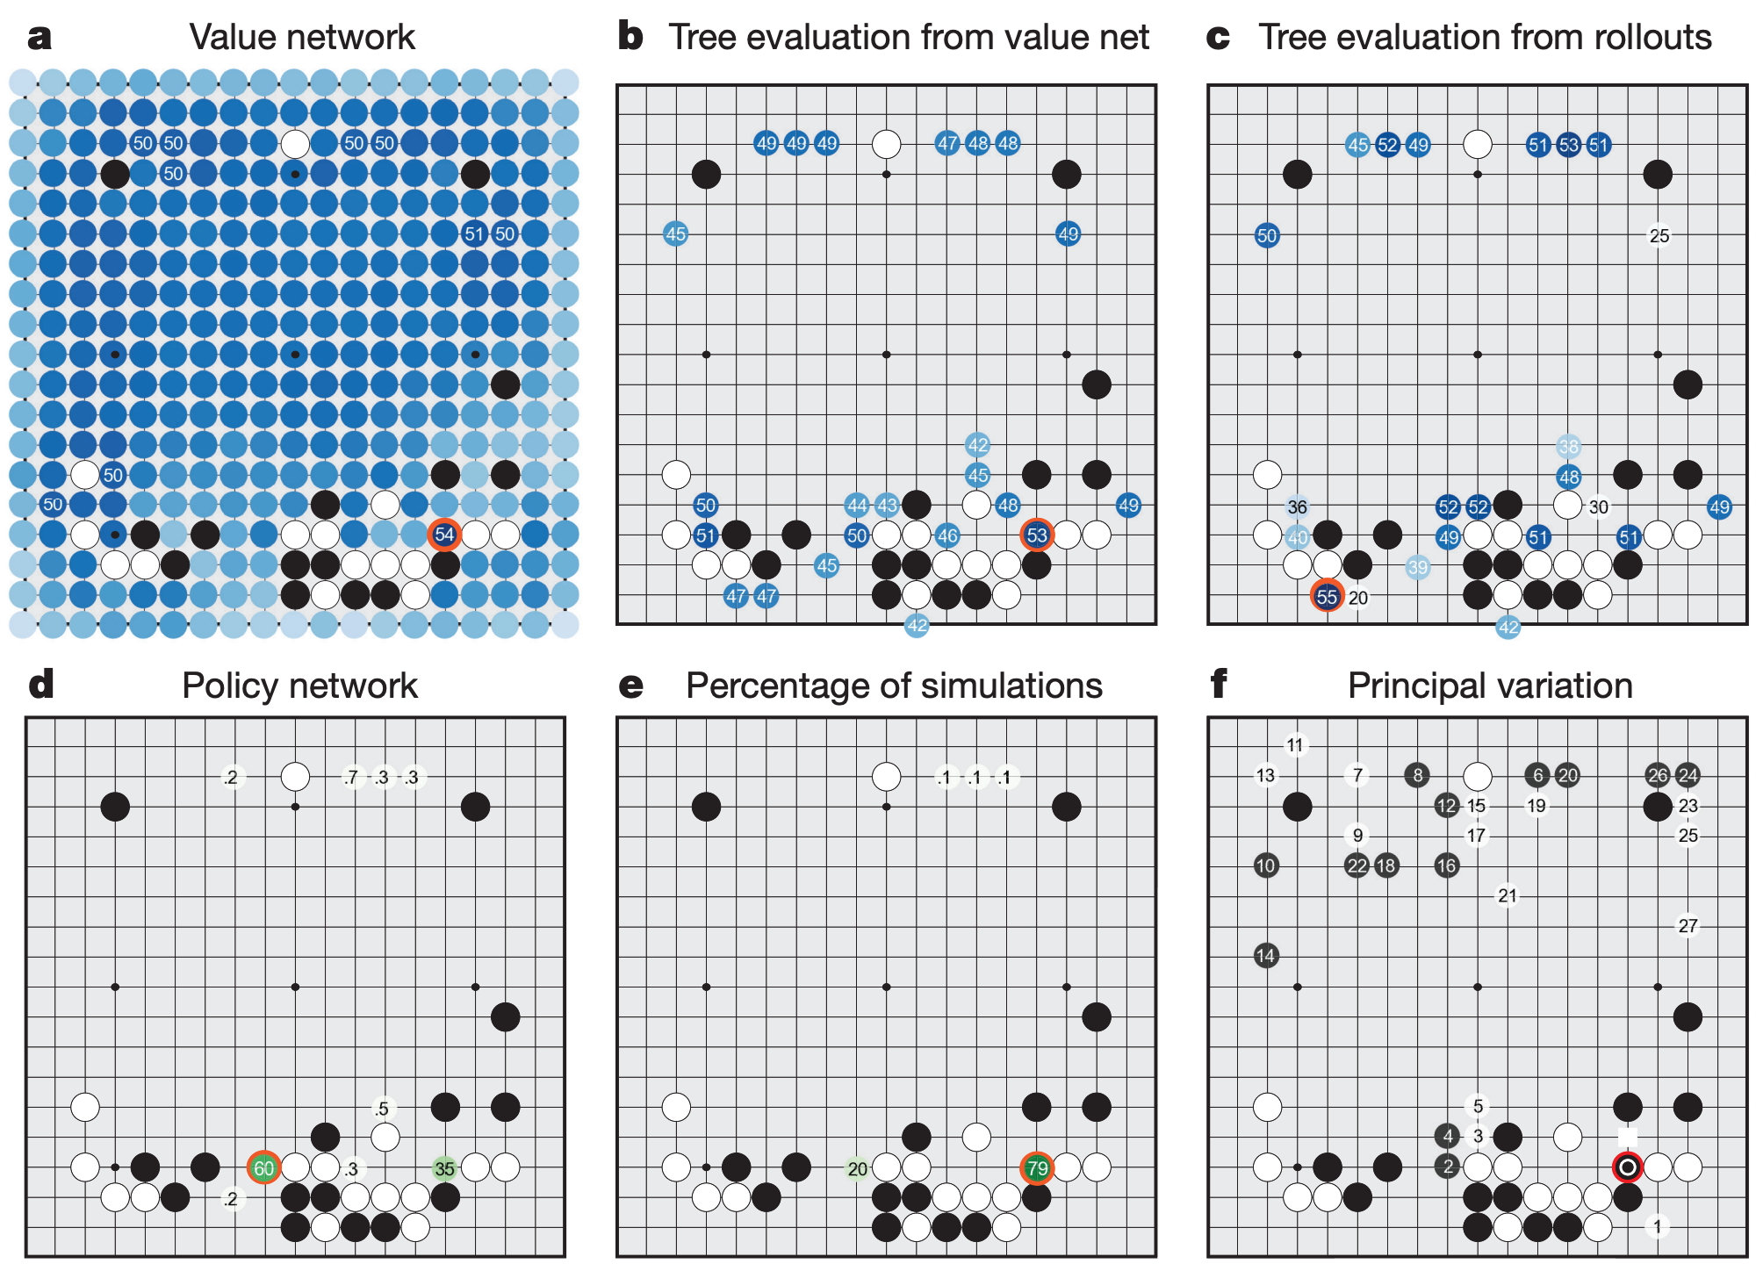
AlphaGo beats top human players
Preferred by human opponent Fan Hui

Slide 29
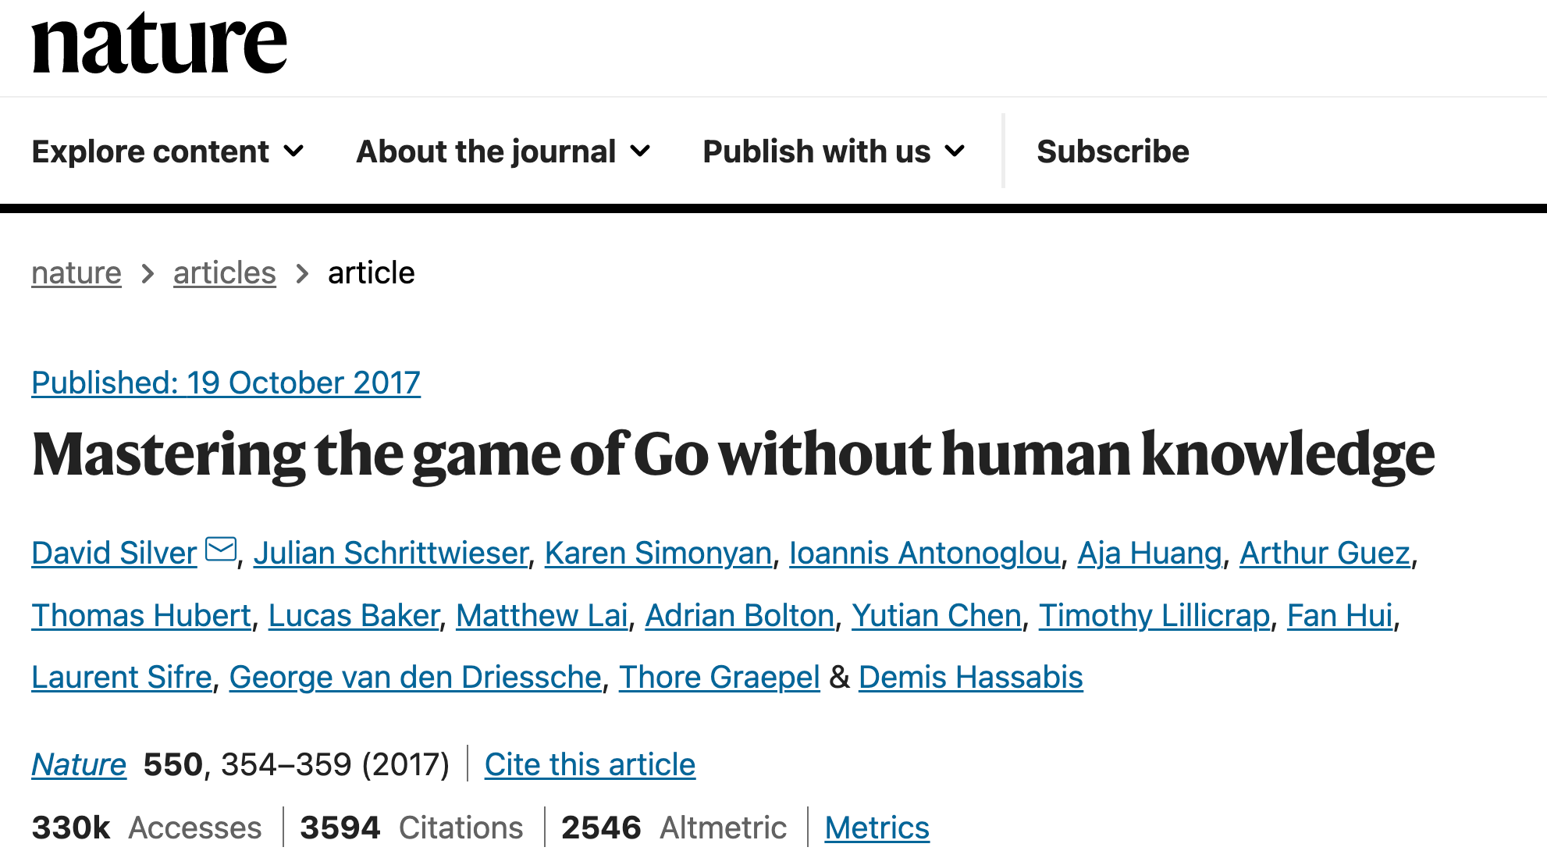

Slide 30
AlphaGo zero: the next level of self-play
Move beyond supervised learning and domain knowledge constructed features
Principle
Predict AlphaGo’s own move and the winner based on the game rule
Designs
Start from random policies
Only use black/white stones from the board as input
Only use a single neural network for both policy and value prediction
A simpler Monte Carlo tree search algorithm

Slide 31
AlphaGo zero
Neural network architecture
Input: $19×19×17$ image stack, where 8 feature planes record the player’s recent moves, 8 feature planes record the opponent’s recent moves, and one suggesting if white or black to play
Structure: residual blocks on top of convolutional layers with batch normalization, ReLU activation
Output: $\left(P,v\right)$, $P$probability of each move and $v$ probability of winning from the current state, i.e., value

Slide 32
Monte Carlo tree search in AlphaGo Zero
It gets simplified by the unified policy-value network
No need to differentiate roll-out policy, supervised policy and RL policy!

Slide 33
Monte Carlo tree search in AlphaGo Zero
It gets simplified by the unified policy-value network
Kind of upper confidence bound principle
Use the predicted value to update policy

Slide 34
AlphaGo zero
Neural network training
Principle: match the improved search results by MCTS
Actions taken by MCTS as policy improvements
Winner of self-play as policy evaluation
Multi-task learning
self-play winner
MCTS search probability
value prediction
policy prediction
regularization

Slide 35
AlphaGo zero
Improved next move prediction of human experts does not lead to improved game play!
Neural network training

Slide 36
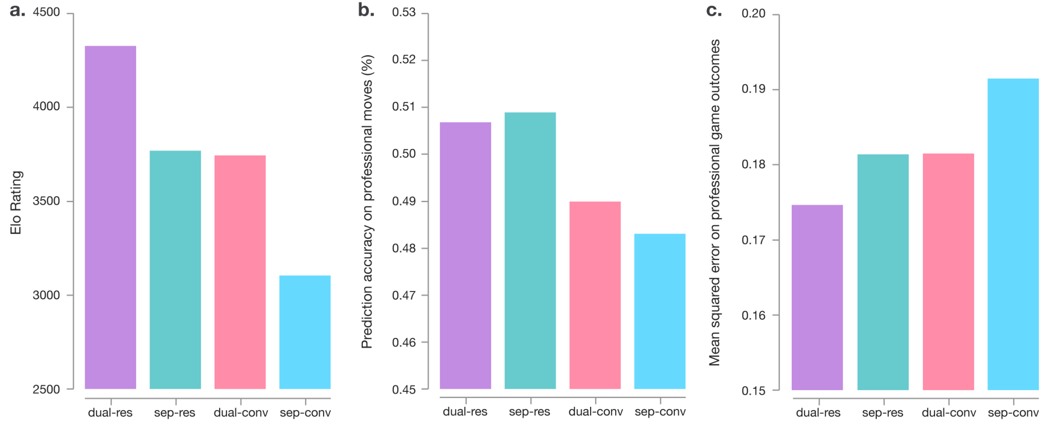
AlphaGo zero
Dual: one network for both policy and value prediction
Sep: one network for policy and one for value prediction
Res: residual network on CNNs
Conv: CNN only
Network architecture matters

Slide 37
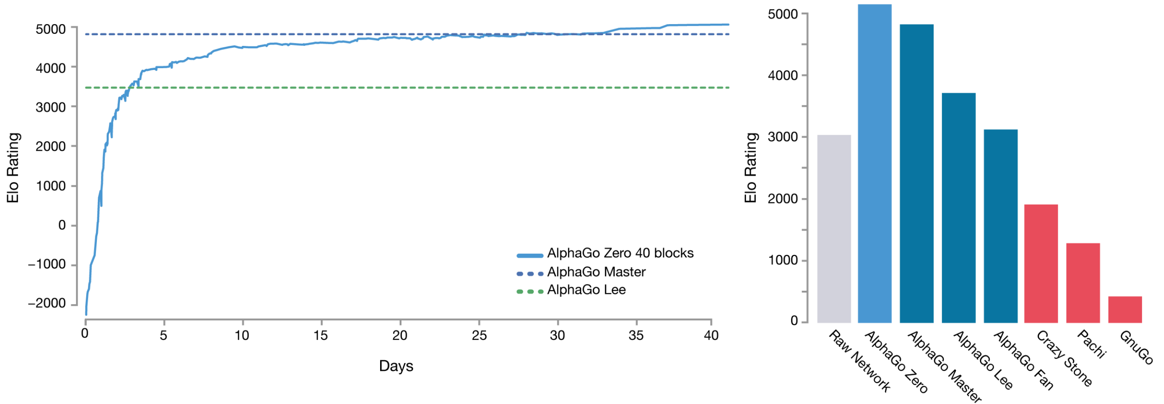
AlphaGo zero
Engineering efforts matter
AlphaGo Zero – single machine with 4 TPUs
AlphaGo Lee – 176 GPUs and 48 TPUs

Slide 38
Recap: RL with approximation
DeepMind chose Q-learning on top of deep neural networks
State encoder: convolutional neural networks
Value network: multilayer perceptron
Input: 210$×$ 160 color video at 60 Hz
$ε$-greedy for exploration
All actions to be evaluated by the Q-function
RMSProp for neural network estimation

Slide 39
Recap: self-play in AlphaGo
Efficiently approached by Monte Carlo tree search
State transition: play current policy network against a randomly selected previous iteration of the policy network
almost like a UCB, but no theoretical confidence interval
where

Slide 40
Recap: Monte Carlo tree search in AlphaGo Zero
It gets simplified by the unified policy-value network
No need to differentiate roll-out policy, supervised policy and RL policy!

Slide 41
Recap: AlphaGo zero
Neural network training
Principle: match the improved search results by MCTS
Actions taken by MCTS as policy improvements
Winner of self-play as policy evaluation
Multi-task learning
self-play winner
MCTS search probability
value prediction
policy prediction
regularization

Slide 42
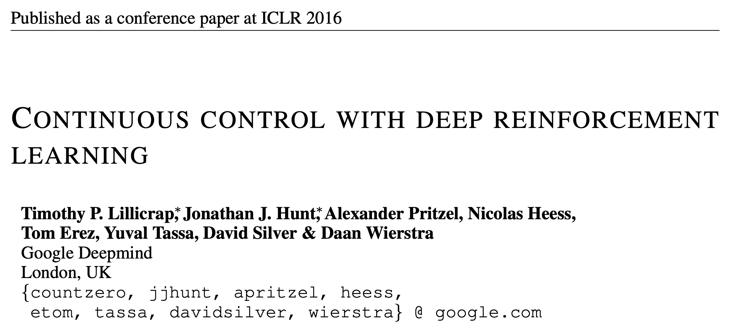

Slide 43
All the following slides are borrowed from Yushun Dong’s 2020 RL presentation.

Slide 45
Our policy network

Slide 47
Our value network

Slide 49
Actor-critic type policy gradient!

Slide 50
Essential our action becomes a distribution
We might have to change our mindset about “optimal action”, which is not necessarily a single action!

Slide 51
Our policy network
Our value network

Slide 54
TD error as our training signal

Slide 55
randomly sampled from replay buffer
Policy gradient with advantage function

Slide 59
Keep the momentum

